Slide 1
2024 IHE-Europe Connectathon What’s new in IT-Infrastructure?
Anne-Gaëlle BERGE
IHE-Europe Connectathon Technical Manager

Slide 2

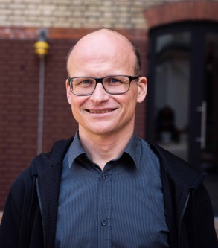
Speakers:
John Moehrke
Architect: Healthcare Informatics Standards - Interoperability, Privacy, and Security IHE Co-Chair IT Infrastructure Planning and Technical HL7 Co-Chair Security WG, FHIR FMG, FHIR facilitator, and FHIR Foundation founding member
Oliver Egger
eHealth Architect Founder of ahdis.ag IHE International ITI Technical Commitee Co-Chair IHE Suisse member HL7.ch member

Slide 3


Slide 4
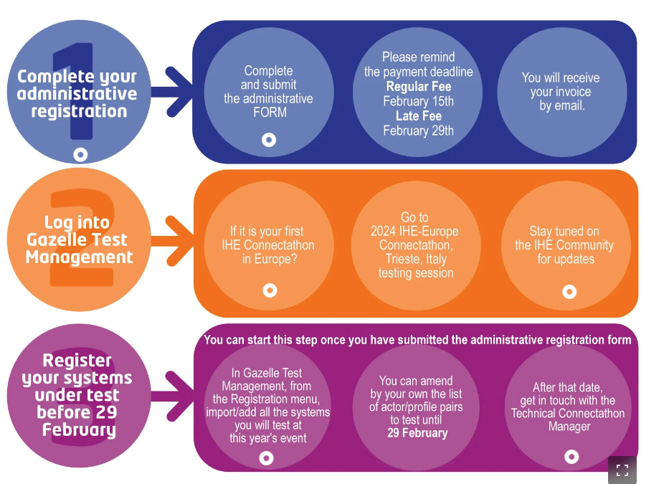
How to register to the event?
https://connectathon.ihe-europe.net/connectathon-week-2024

Slide 5
Agenda
Introduction of the IT-Infrastructure domain: what does it cover in terms of business cases
What is new since the last Connectathon?
Focus on hot profiles
Q&A session

Slide 6
IT-Infrastructure
The IT Infrastructure Domain defines interoperable infrastructure for the secure sharing of healthcare information independent of clinical domain. Interoperable infrastructure is necessary to support common IT functions for a variety of use cases but is rarely visible to the end user.
Components supporting interoperable infrastructure may be embedded in applications but are often deployed as a shared resource within an organization or a regional or national health information exchange.
IHE ITI was established by HIMSS & RSNA in 2002 in order to address use cases that cross multiple clinical domains and rely on a common IT Infrastructure.

Slide 7
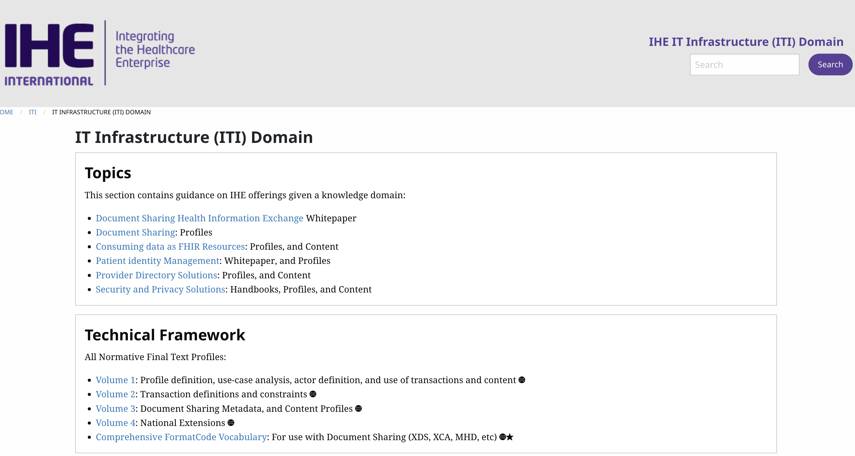
IT-Infrastructure
https://profiles.ihe.net/ITI/

Slide 8
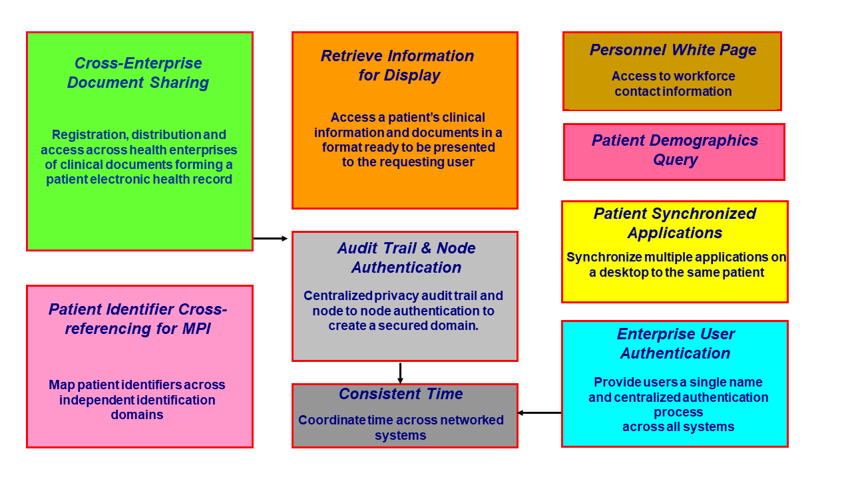
IT-Infrastructure
https://profiles.ihe.net/ITI/TF/Volume1/ch-2.html

Slide 9
ITI – Profiles most tested at CAT
Consistent Time (CT)
Audit Trail and Node Authentication (ATNA)
Cross-Enterprise Clinical Documents Share (XDS.b)
Mobile access to Health Documents (MHD)

Slide 10
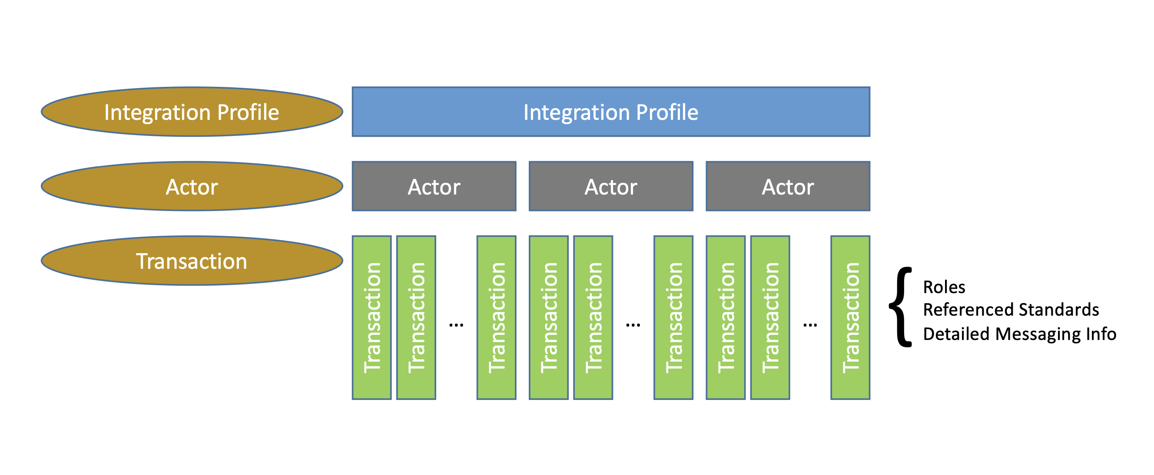
IT-Infrastructure
https://www.ihe.net/about_ihe/faq/ - What_is_the_IHE_Technical_Framework?

Slide 11
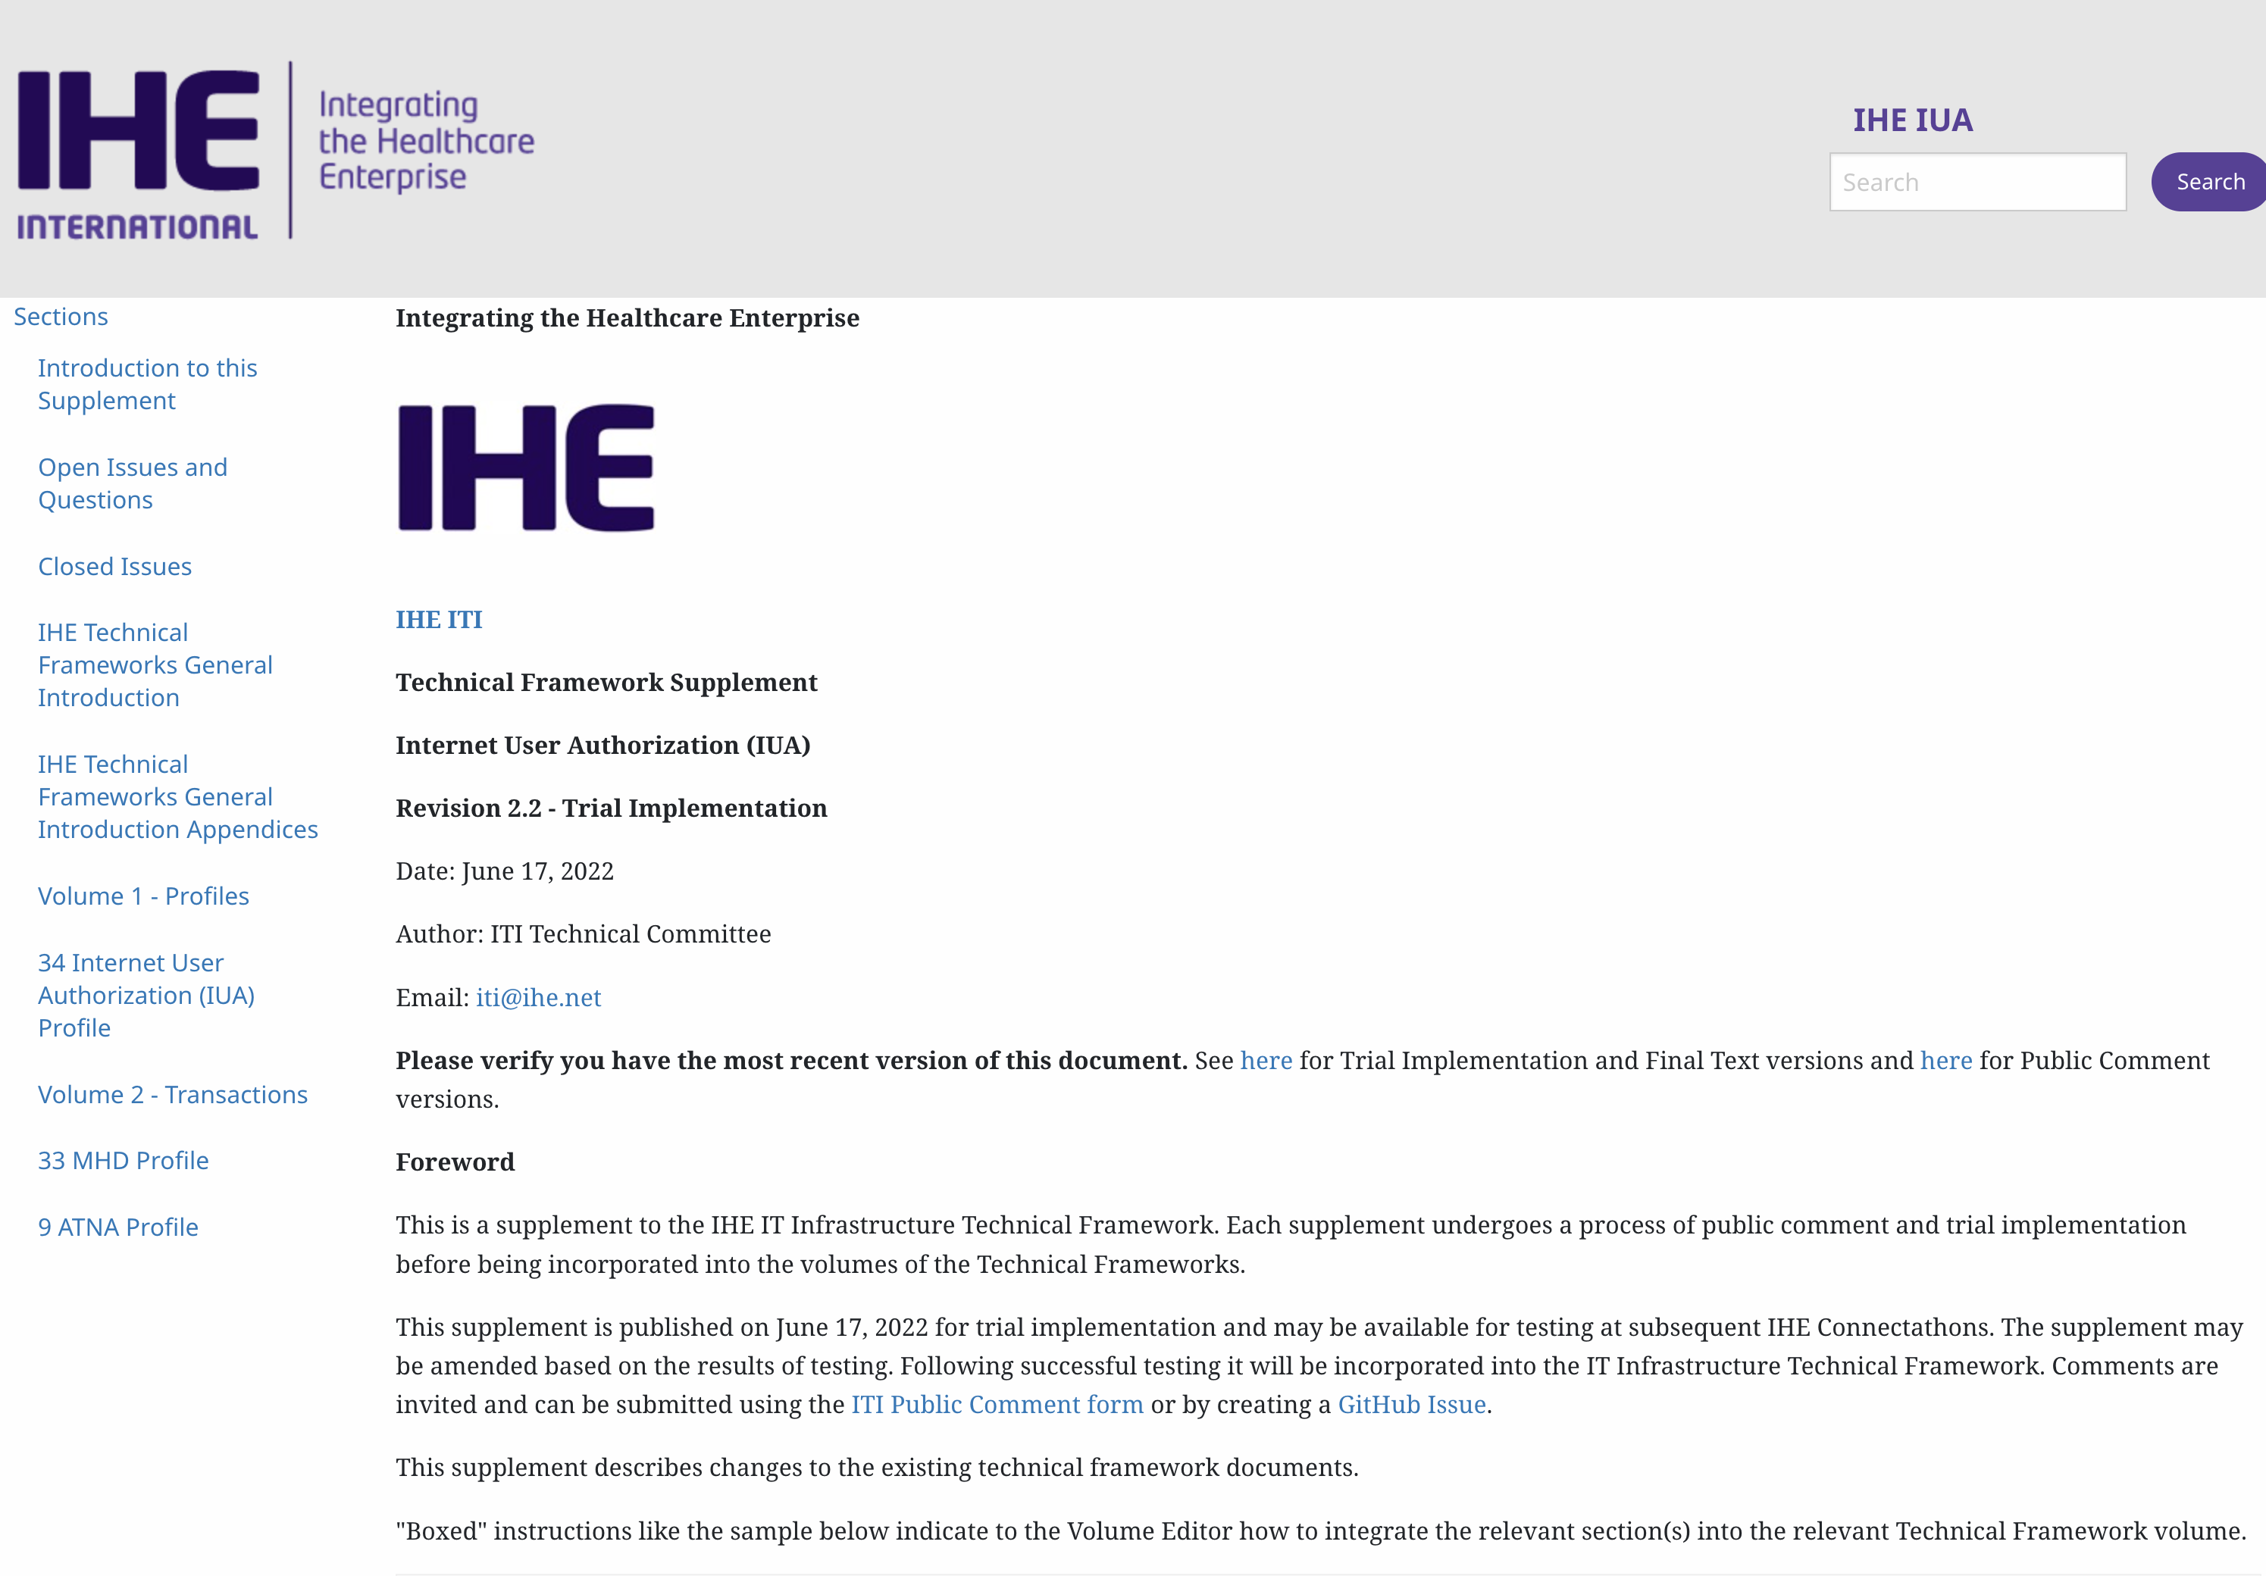
Internet User Authorization (IUA)
https://profiles.ihe.net/ITI/IUA/index.html

Slide 12
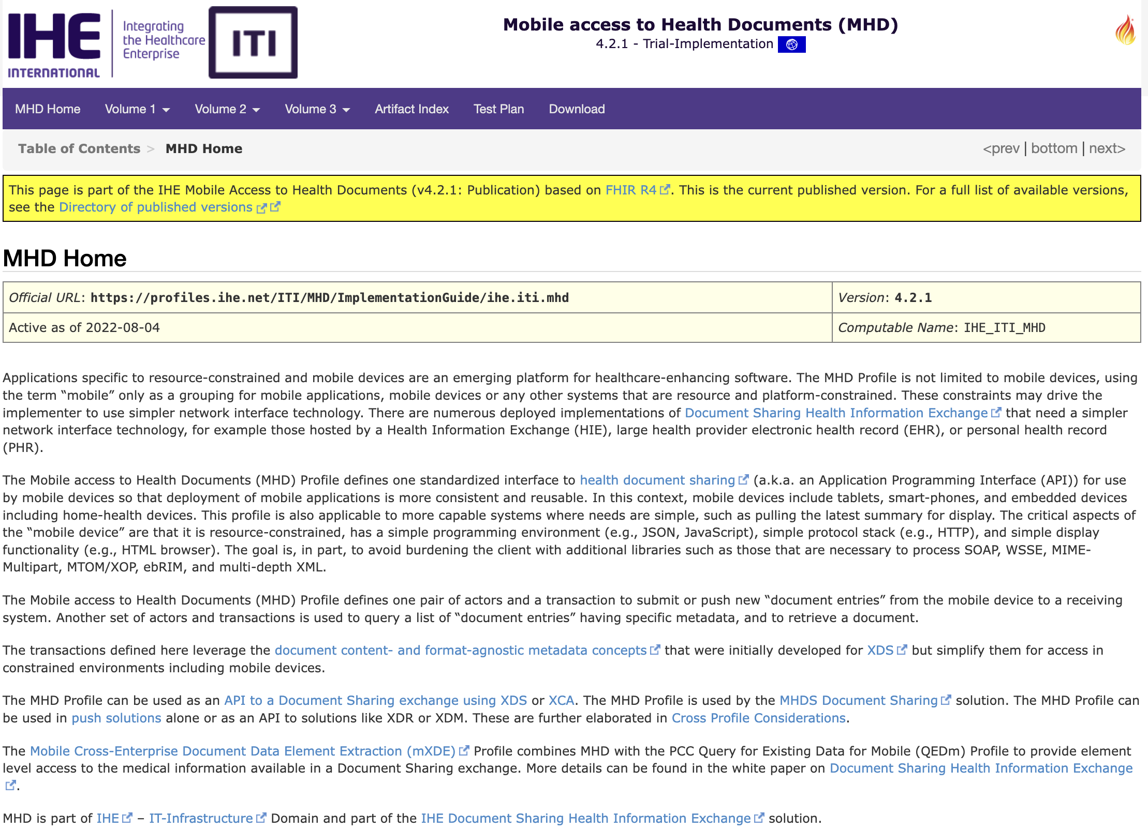
Mobile access to Health Documents (MHD)
https://profiles.ihe.net/ITI/MHD/index.html

Slide 13
IHE Profile Development Process
Allmost all IHE «mobile» Profiles are now published as FHIR Implementation Guides with
Actors, Transactions defined
Conformance Resources (StructureDefinitions, ValueSets, CodeSytems, ConceptMaps, Extensions etc)
and with examples!
Facilitates also testing because Implementation Guides can be used for validation during development.

Slide 14
IHE Profile Development Process
IHE ITI Planning Committee and Technical Committee
Work Item Proposal
Monthly Planning Meeting
Bi-weekly Telcos for Work Items
4 yearly F2F or virtual weekly meeting for work item development
Public Comment Phase
Trial Implementation
https://github.com/IHE/IT-Infrastructure/projects/2

Slide 15
Revised Profiles since August 2023
Asynchronous AS4 Option
Cross-Community Document Reliable Interchange (XCDR)
Cross-Community Patient Discovery (XCPD) Health Data Locator and Revoke Option
Extensions to the Document Metadata Subscription (DSUB) Profile
Remove Metadata and Documents (RMD)
XDS Metadata Update
Add RESTful ATNA (Query and Feed)
Mobile access to Health Documents (MHD)
Mobile Health Document Sharing (MHDS)
Mobile Care Services Discovery (mCSD)
Basic Audit Log Patterns (BALP)
Patient Master Identity Registry (PMIR)
Sharing Valuesets, Codes, and Maps (SVCM)
Patient Identifier Cross-reference for Mobile (PIXm)
https://profiles.ihe.net/ITI/

Slide 16
Major Profile Updates since August 2023
New Profiles:
Sharing of IPS (sIPS)
Document Subscription for Mobile (DSUBm)
Privacy Consent on FHIR (PCF)
New FHIR Implementation Guides:
Non-patient File Sharing (NPFS) as Implementation Guide
Mobile Cross-Enterprise Document Data Element Extraction (mXDE)
Significant Update:
Patient Demographics Query for mobile (PDQm) with $match
https://profiles.ihe.net/ITI/

Slide 17
In development
Scheduling for Mobile
ITI sex and gender profiling (CP)
DSG handling of JSON signature
Finance and Insurance Services
Update HIE Whitepaper based on recent profiles and updates
https://github.com/IHE/IT-Infrastructure/projects/2

Slide 18
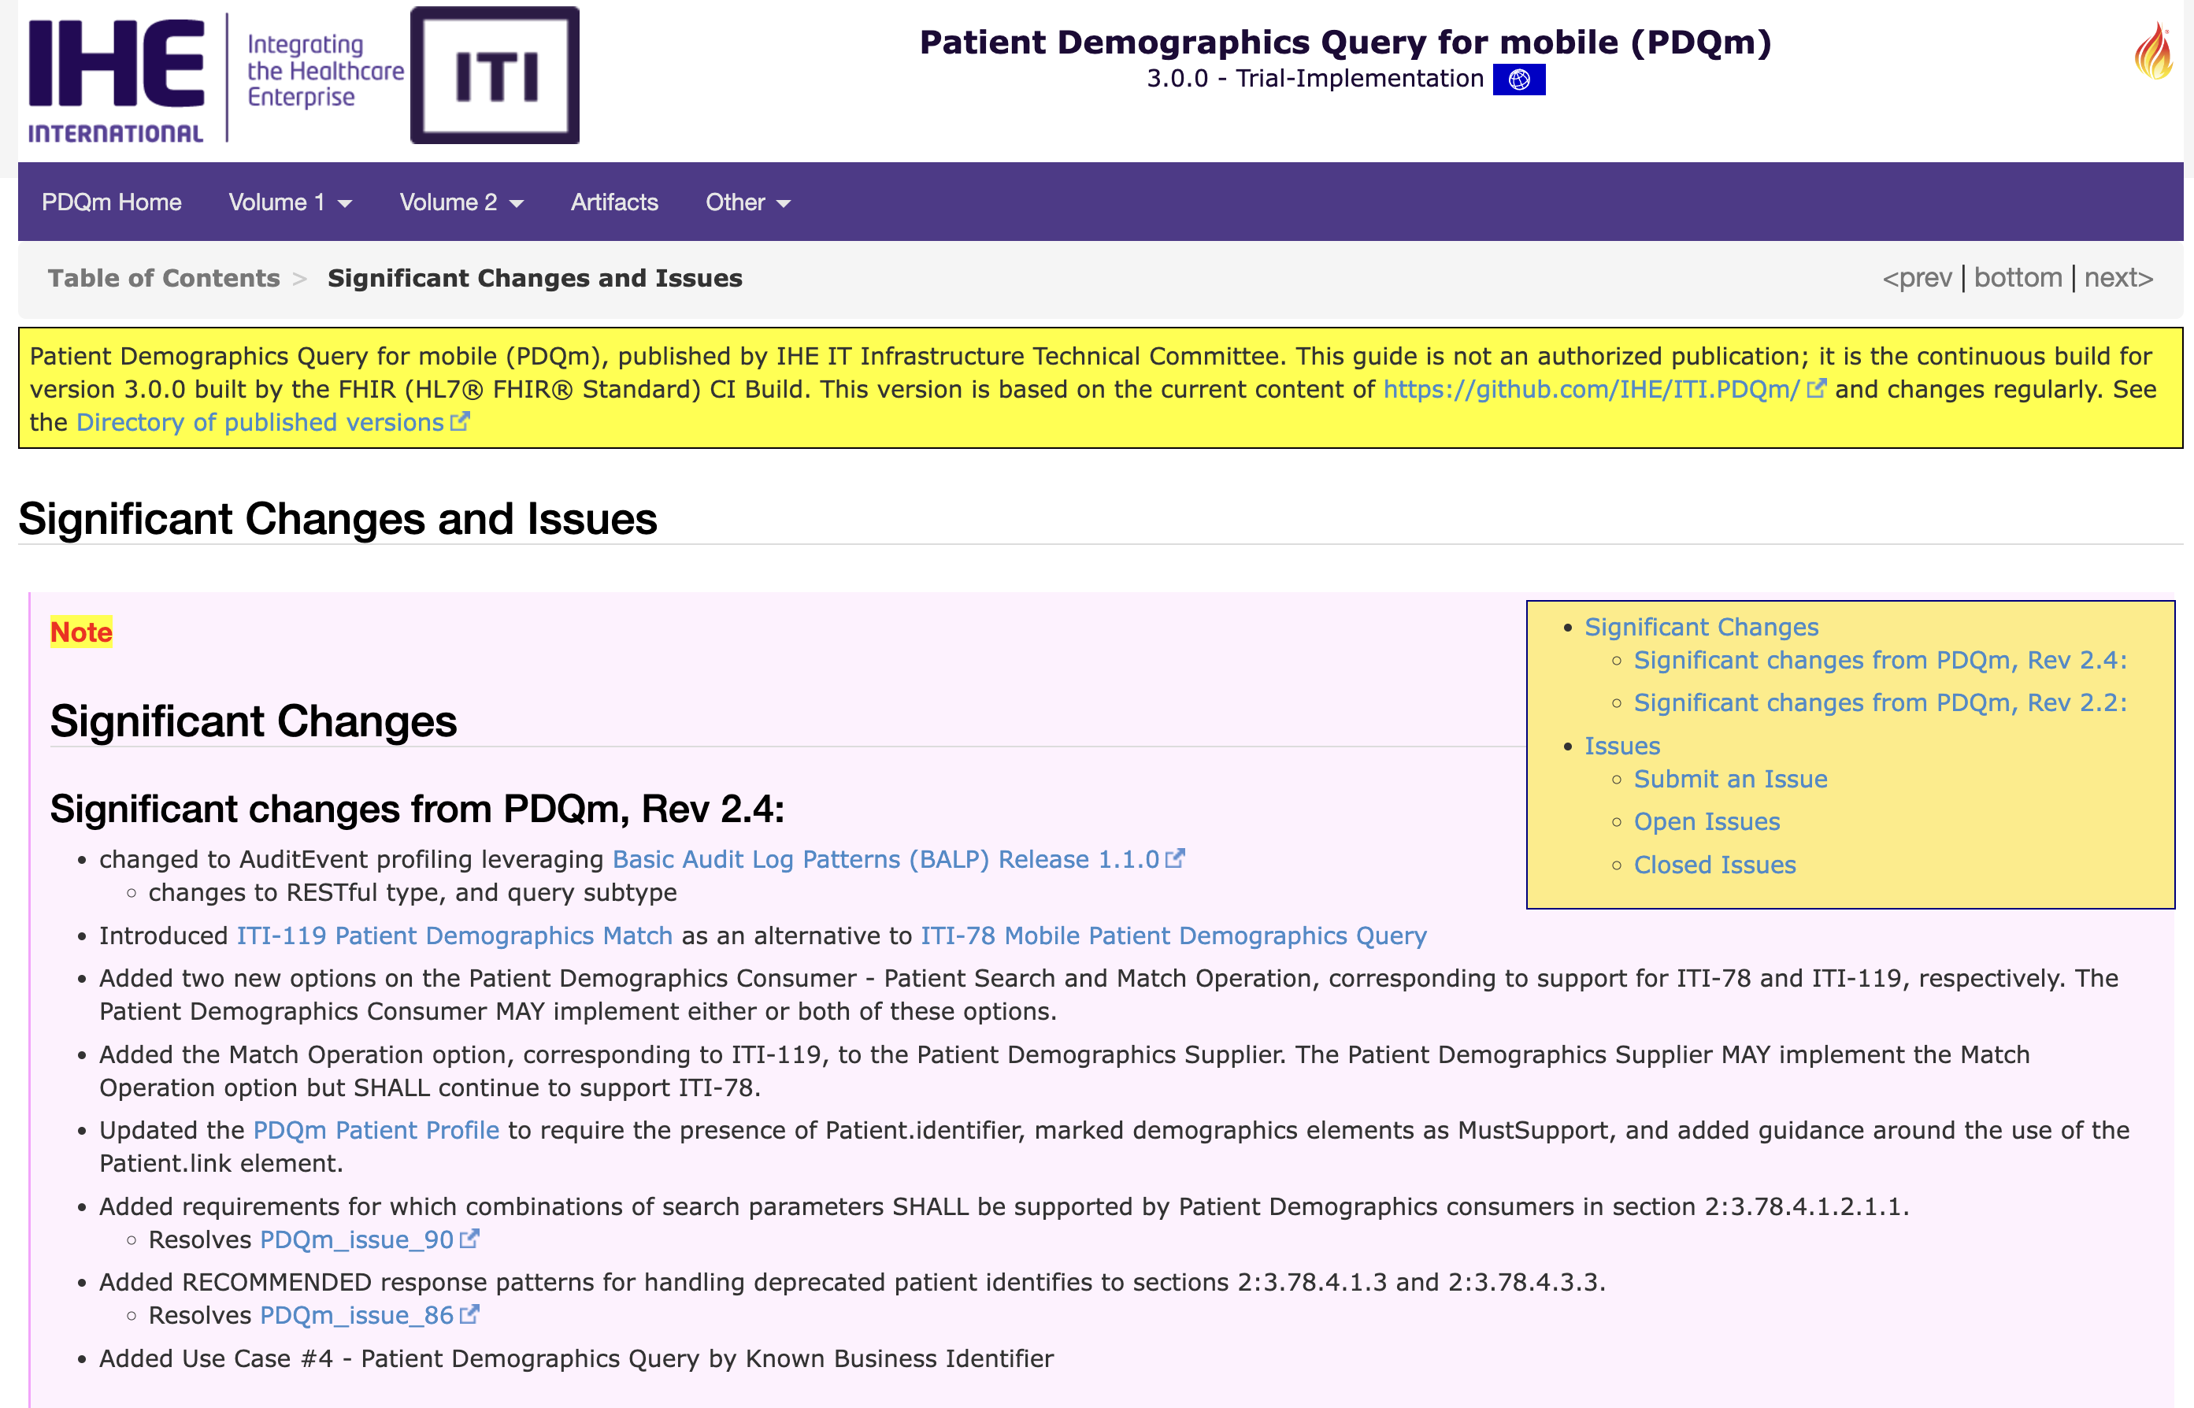
Hot profiles for CAT – PDQm with $match
Introduced ITI-119 Patient Demographics Match as an alternative to ITI-78 Mobile Patient Demographics Query
https://build.fhir.org/ig/IHE/ITI.PDQm/branches/main/issues.html

Slide 19
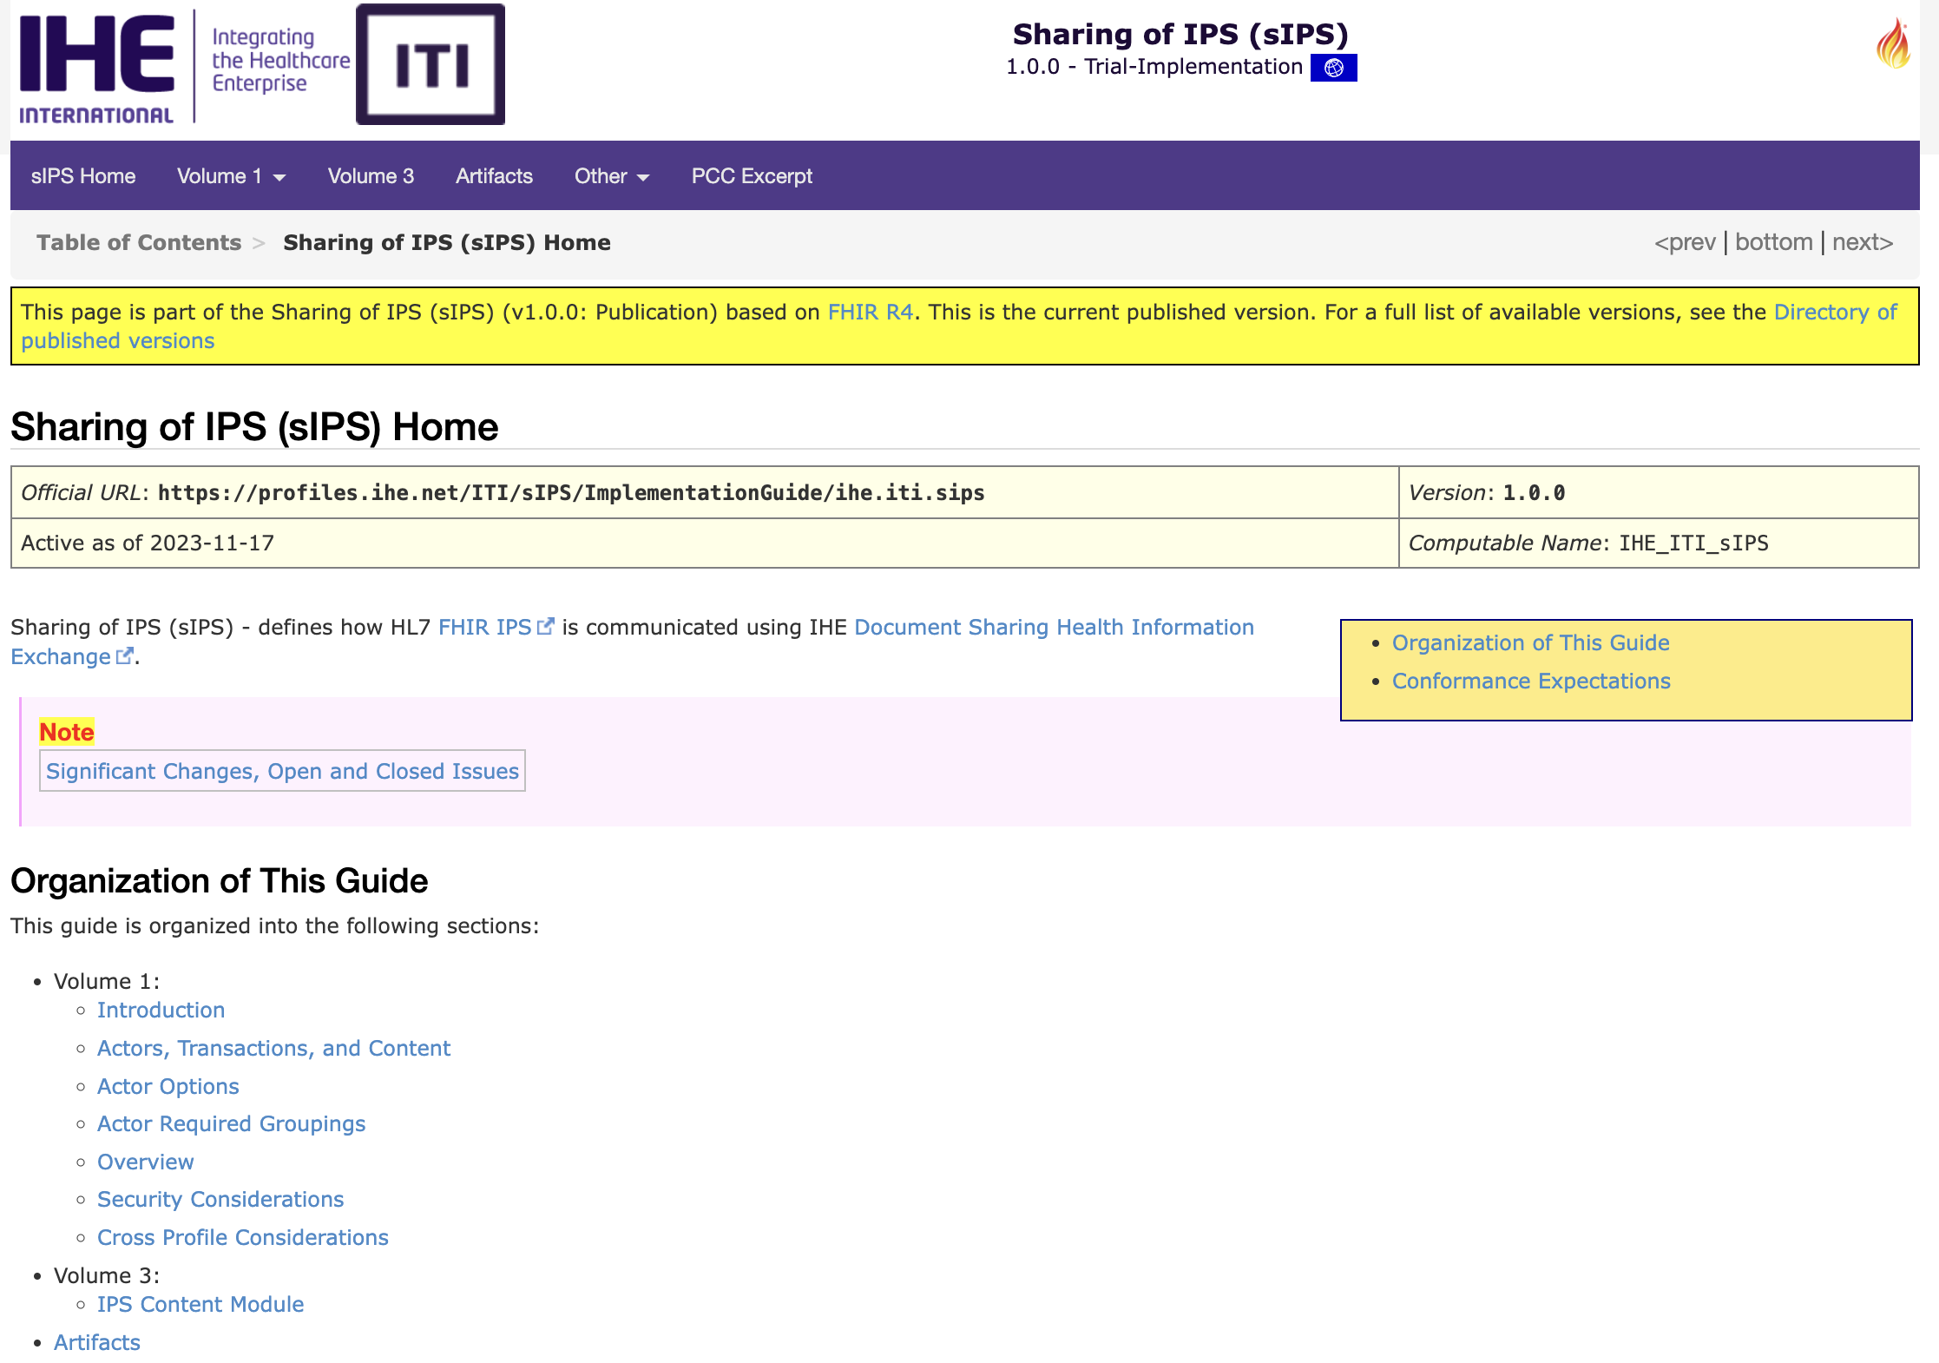
Hot profiles for CAT – sIPS
Publishing an IPS
On Demand Access to an IPS
Retrieving an IPS
Pushing an IPS to a Recipient
https://profiles.ihe.net/ITI/sIPS/

Slide 20
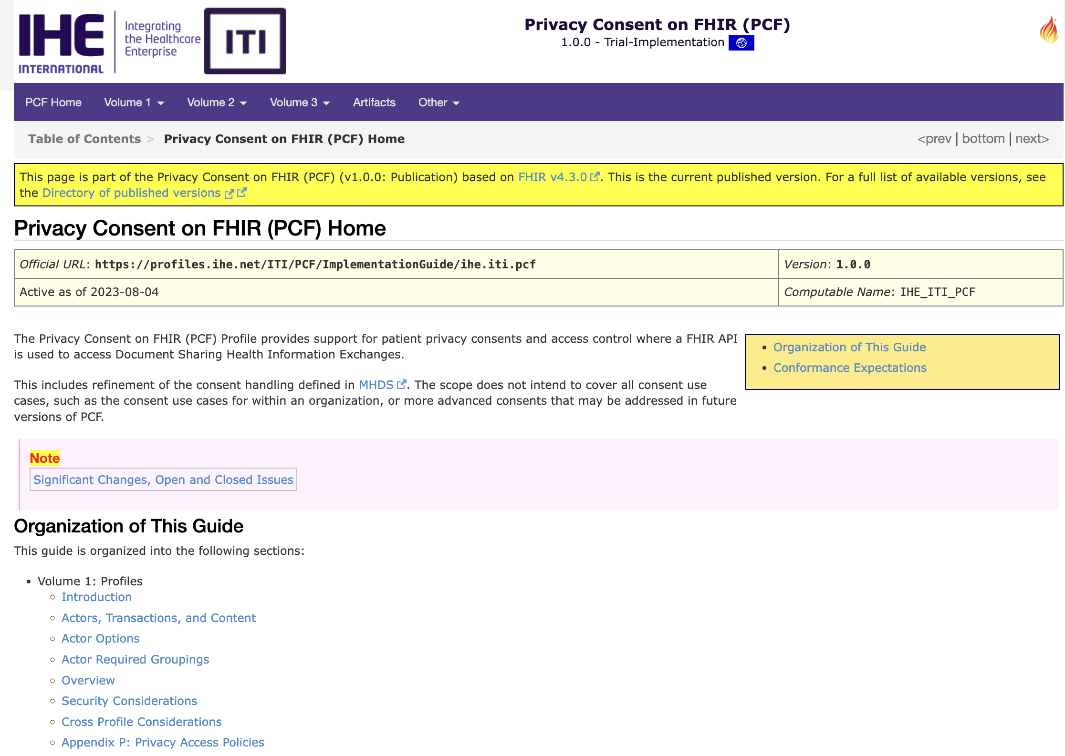
Hot profiles for CAT – PCF
The Privacy Consent on FHIR (PCF) builds upon a basic Identity and Authorization model of Internet User Authorization (IUA) to provide consent-based access control.
The Privacy Consent on FHIR is thus focused only on Access Control decisions regarding the parameters of the data subject (patient) privacy consent
https://profiles.ihe.net/ITI/PCF/

Slide 21
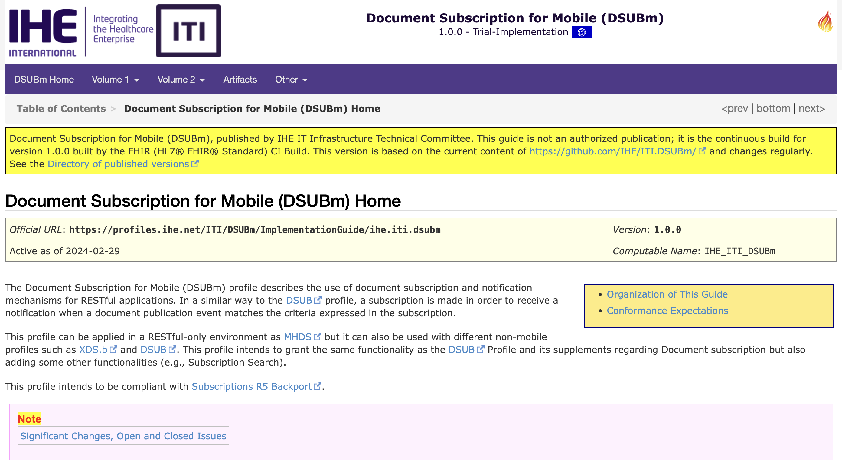
Hot profiles for CAT – DSUBm
Passed from R4B to R4 version of FHIR
Profiling the SubscriptionTopic as Basic resource
Profiling the SubscriptionStatus as Parameter resource
Eliminated the duplication of MHD artifacts
https://build.fhir.org/ig/IHE/ITI.DSUBm/branches/master/index.html

Slide 22
Q&A

